Slide 1
Multifamily Initiative
Program ally Orientation

Slide 2
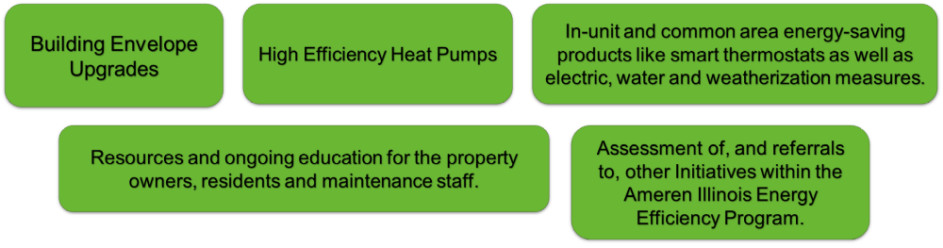
Multifamily One-Stop Shop Initiative
The Ameren Illinois One-Stop Shop (OSS) Initiative provides access to Multifamily properties and renters with energy efficiency retrofit and upgrades that provide benefits that will endure for the buildings and benefit renters in their homes for many years to come.

Slide 3
Property Qualifications
What properties can be served under Multifamily?
A minimum of three units (connected and in the same building) under the same ownership.
Heating fuel must be delivered by Ameren Illinois.
What can that look like?
It can be a mix of apartment-style as well as tri/quad-plexes.
  (3- or 4-unit residential buildings, with its own entrance. Units can be arranged side-by-side, stacked vertically or a mix).
Duplexes (public housing only).
Student apartment housing.
Senior living or facilities for people with disabilities (nursing homes do not apply).
Mixed-use building (retail or office with attached residential).
What if it doesn’t have Ameren Illinois residential accounts?
Many properties roll utilities up into the rent, so there may not be a residential account for the address.

Slide 4
Multifamily Eligibility Types
Public Housing (PH)
All units must be owned or managed by a Public Housing Authority.
Income Qualified (IQ)
Property must be able to show participation in a government rental assistance program (e.g., Sec 8, Sec 515, 550, etc.), an income-qualified assistance financing program such as USDA, LITC, LIHTC, or RAD; or is receiving federal disaster assistance OR determined based on HUD Fair Market Rent Levels (FMR).
Market Rate (MR)
Properties that are not eligible under PH or IQ qualifiers are designated as market rate.
Incentives are based on property eligibility.

Slide 5
Program Ally Requirements
Program Ally must be and remain in good standing with Ameren Illinois Energy Efficiency Program
Current Certificate of Insurance
ICC Certification
BPI BA-P certification (BE projects only)
Completion of Required Training Multifamily Ally Orientation (this training)
Fuel Distribution System Inspection Procedure (30-minute video)
Paperwork Training (handled more in-depth during your first project)

Slide 6
Multifamily One-Stop Shop Initiative
Heat Pump Offering

Slide 7
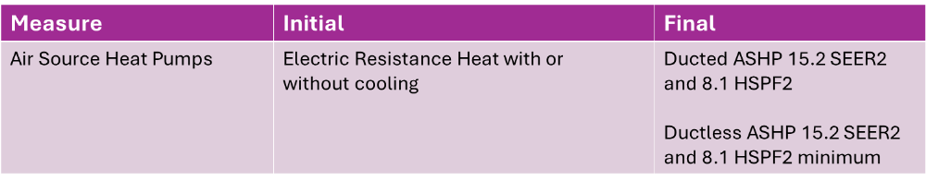
Multifamily HVAC ASHP Requirements
Initial Conditions for Multifamily Retrofit Projects
Ducted or Ductless Air Source Heat Pumps
  Offered in all three multifamily channels (IQ, PH & MR).
  Heating fuel must be delivered by Ameren Illinois.
  Replacing the operable electric resistance heating unit as the primary source of heat for the tenant’s unit.
  Heat pump must meet 15.2 SEER2 and 8.1 HSPF2 as certified by AHRI certificate.
  AHRI certificates for each proposed model must be submitted with the application.
  If the system is determined to require a thermostat, a smart thermostat must be installed and covered within the cost of the incentive. Our team may be able to provide smart thermostats, if needed, based on equipment.

Slide 8
Multifamily Air Source Heat Pump Incentives
HVAC Retrofit Measures | Eligible Channel | Incentive
Ductless or Ducted ASHP | Income Qualified & Public Housing | $6,500
Ductless or Ducted ASHP | Market Rate | $5,500
Cold Climate HP Surcharge | Income Qualified & Public Housing | $1,000

Slide 9
Multifamily Heat Pump Project Flow
I located a property that is interested in participating in the Multifamily Initiative.
What’s next?
I have been contacted by the Multifamily Initiative team regarding a potential project. What’s next?
Direct the property to AmerenIllinoisSavings.com/Property to submit a Request for an Assessment.
Be sure to advise the property to include your name/business name as the “Referring Ally” on the application.
You will be contacted by the Multifamily Initiative team once eligibility is confirmed and the assessment is complete.
Complete HVAC workbook and submit required documentation for approval to start project.
Eligibility has already been determined, and the Multifamily Initiative team has completed the assessment. Applicable and eligible measures have been discussed with the site contact.
The property has been provided with at least three(3) Program Allies to contact.
Please reach out to this site as soon as possible to coordinate timelines, discuss scope of work and confirm their interest in the moving forward. Note: It is the property’s sole discretion on which Program Ally is selected.
Once property has selected a Program Ally, the Program Ally will complete HVAC workbook and submit required documentation for approval to start project.

Slide 10
Multifamily Heat Pump Project Flow
Ally submits signed reservation request including supporting documents to the Multifamily residential inbox for initial review.
  Application documents including HVAC equipment certification and unit details.
  Separate applications must be submitted for each project phase if the property is being broken into multiples phases.
  Required invoice should include property information, scope of work notating units (broken into phases, if applicable) and Ameren incentive.
  All required fields on the workbook must be completed.
  Requested corrections are expected within 72 hours.
Note: OSS number AND property signature must be on the approval request.
Projects are then reviewed by the program team and sent to Ameren Illinois Technical Review for approval.
Upon Technical Review approval, the program ally is notified and may begin the project.
  Note: Please wait to obtain your approval before beginning your installation.
Program Allies complete all necessary work outlined in the work scope. If work or equipment changes, please promptly notify the program team.
Property Signature is required with the final submission of projects for payment.
Allies submit incentive requests, including the project AMIL# (located in the reservation approval email) and all required supporting documents (post-installation photos) to the program team for review before sending to TR for final approval before processing payment. Payment can be within 4-6 weeks after incentive request approval.

Slide 11
Special Considerations & Expectations
The program experience for the tenant and property personnel (owner/manager) is important to Ameren Illinois.
Prompt and accurate project communication (timelines, costs, etc.).
Site cleanliness (unit and surrounding building).
Property managers must inform tenants of scheduled installation 24-48 hours in advance.
Minimize disruption to the tenants (limit noise where possible, maintain professionalism, etc.).
Repairs to exterior façade and interior wall, if wall air conditioners must be removed, are the property's responsibility.
Follow site requirements with regards to lockup after unit entry.
Be cognizant of the tenants' concerns and/or any special needs, especially for seniors or disabled persons.
Each tenant unit to be entered should provide confirmation at the door of the H&S questions or concerns before PA Staff entering the unit. Ensure to inform the Property Manager and note for reference.
Communication with property staff and the program team to address or document tenant concerns or refusal for entry.
Ensure management and/or maintenance understands how to operate and maintain the system to optimize efficiency and limit callbacks. Also, share any warranty or service agreement information for ongoing support.

Slide 12
Post Inspection
Expectations and Requirements:
Contact your field energy specialist at least one week prior to completing your installation to schedule the required post-installation inspection for building envelope projects.
A visual inspection will be conducted on a portion of the installed heat pumps. The program team will schedule based on your project completion date.
Inspection will verify the following:
  The correct HVAC equipment was installed as per the submitted/approved application & AHRI certification.
  The unit is level and securely mounted.
  The area is free from any obstructions, including walls, overhangs and structures.
  If applicable, confirm that thermostats have been installed.
  Thermostats are placed on interior walls, away from direct sunlight, appliances and drafts.
  Visible line sets are covered with transitions and matching termination fittings.
  The condensate line was installed without dips or traps.
  Owner manual(s) and any other applicable educational resources have been provided to the property/tenant.
  The tenant and property staff (maintenance, management, etc.) have been instructed on how to operate including turning the heat pump on/off, switching between heating/cooling modes, adjusting airflow direction and setting temperature.
Post-installation photos of installed HVAC systems must be submitted with final incentive request workbook. The inspector may take additional photos if needed. Please keep in mind that post-installation photos and inspection is a requirement before payment processing.

Slide 13
Multifamily one-stop shop Initiative
Building Envelope Offering

Slide 14
Multifamily Building Envelope Requirements
Initial Conditions for Multifamily Building Envelope Projects
Building Envelope Measure | Initial | Final
Air Sealing | Pre blower door testing required | Post blower door testing to verify CFM reduction
Attic Insulation | R11 or less | Improved to R49 or greater
Attic Insulation | R12 to 19 | Improved to R49 or greater
Attic Insulation | R20 to R30 | Improved to R49 or greater
Wall Insulation | R0 to R11 | Improved to R12 or greater
Rim Joist Insulation | R0 to R10 | Improved to R11 or greater
Crawl Space Wall Insulation | R0 to R10 | Improved to R11 or greater
Non project Stipend | $100 per Building ( max 3 buildings)
  Air sealing opportunities must be available.
  Air sealing of the entire attic plane is required.
  Heating fuel must be delivered by Ameren.
  Building Envelope measure applies to Income Qualified and Public Housing properties.

Slide 15
Multifamily Building Envelope Incentives
Building Envelope Measure | Income Qualified Incentive | Public Housing Incentive
Air Sealing | $0.95 per CFM 50 ( max $5,000) | $0.70 per CFM 50 (max $5,000)
Attic Insulation | $1.90 per SF | $1.90 per SF
Attic Insulation | $1.55 per SF | $1.55 per SF
Attic Insulation | $1.25 per SF | $1.25 per SF
Wall Insulation | $2.30 per SF | $2.30 per SF
Rim Joist Insulation | $5.05 per LF | $5.05 per LF
Crawl Space Wall Insulation | $8.85 per LF | $8.85 per LF

Slide 16
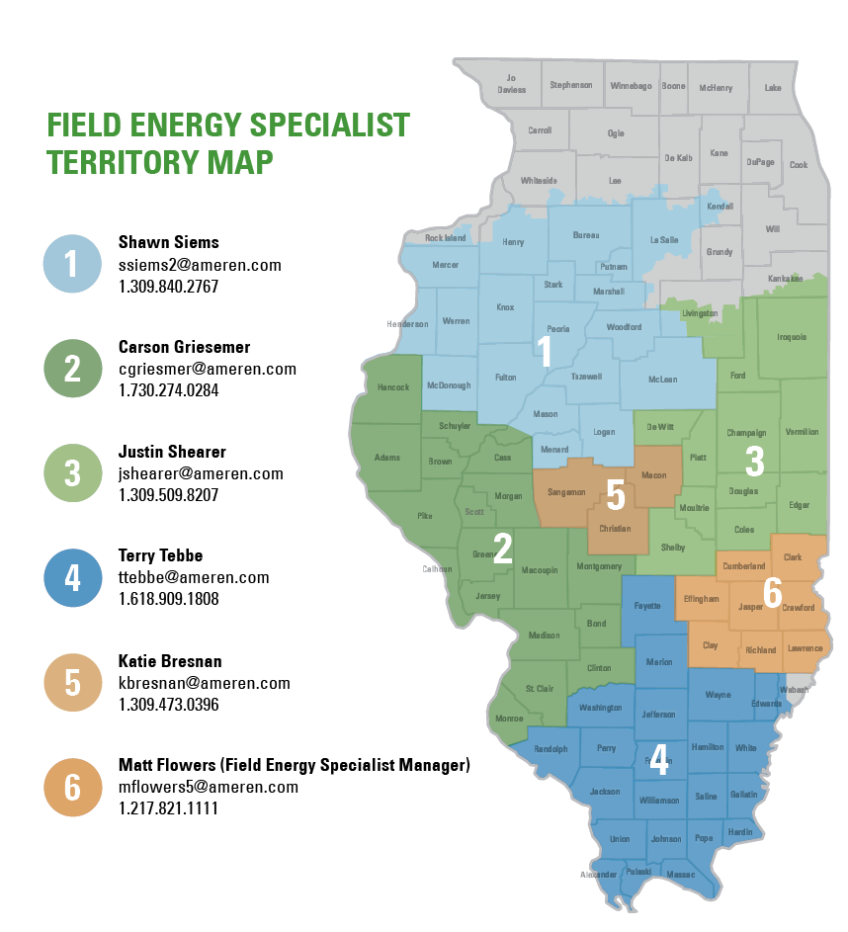
Multifamily Building Envelope Project Testing
Requirements and Support
Depressurized Infiltration testing CFM@50
Combustion Safety Testing
Fuel Distribution System Inspection
Health & Safety Inspection
Follow BPI requirements for personal safety during assessment and test out.
Please coordinate with your Field Energy Specialist to schedule your pre- and post- blower door tests as well as confirm your intended start date.

Slide 17
Multifamily Building Envelope Project Flow
Referring Program Allies or CMC Energy identifies potential projects.
Selected PA coordinates pre-blower door test and site inspection with assigned Field Energy Advisor.
  BPI BAP certification is required for the individual performing testing.
PA submits reservation requests to the Multifamily general inbox for initial review.
  Completed Application including all supporting documentation and photos
  Tabs required for completion include Inspection Disclaimer Form, Combustion Safety Form, as well as Terms & Conditions
  Health & Safety Measures must be recorded on application
  Note: Ensure the correct OSS number is present on the application as well as the property signature.
Reservation Request ready for TR review must be sent to the CMC Program Assistant.
Once approved by TR, PA may proceed with the project ensuring to communicate project start, progress, issues, and completion to their Field Energy Specialist.
Allies complete all necessary work outlined in the workbook.
Allies coordinate and conduct Post-Work test out.
  Field Energy Specialist must be aware of all testing.
Property signature is required with the final submission of projects for payment.
Allies submit incentive requests, and all required supporting documents including photos to the Multifamily general inbox for final review.
Submitted to TR for final approval before processing payment. Payment can be within 4-6 weeks after incentive request approval.

Slide 18
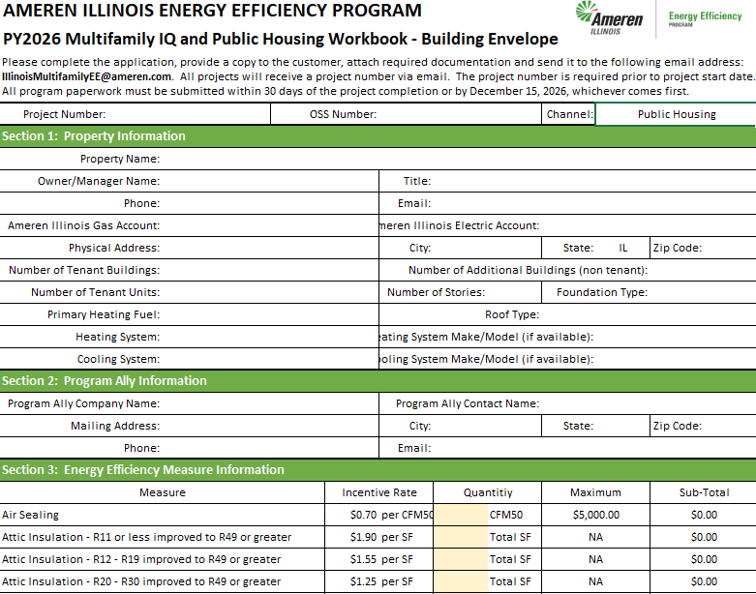
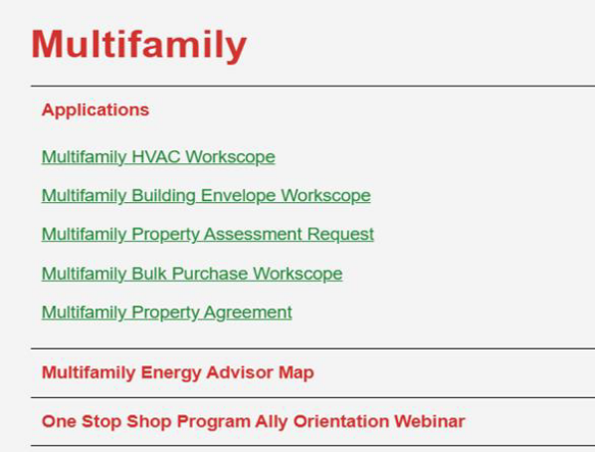
Multifamily Building Envelope Project Flow
All tabs must be completed:
  Building Envelope Workbook
  Building Envelope Unit Details
Must include pre-blower door test and estimated air sealing number
  Combustion Safety Form
  Health & Safety Costs (price sheet also included)
  Terms & Conditions

Slide 19
Non-Project Stipend Audits
This applies to properties that were referred to the Program Ally by the Ameren Illinois Energy Efficiency Program, but do not qualify or cannot proceed due to testing, showstoppers or overqualified insulation.
If you contact the Program Assistant looking for leads, which we confirmed have not been qualified for HVAC and BE, and you visit to determine they are not, then you will not be paid the non-project stipend.
Non-Project Audit Stipend: $100 per building
  No more than 3 buildings per property should be audited.
  Maximum of $300 non-project stipend per property.

Slide 20
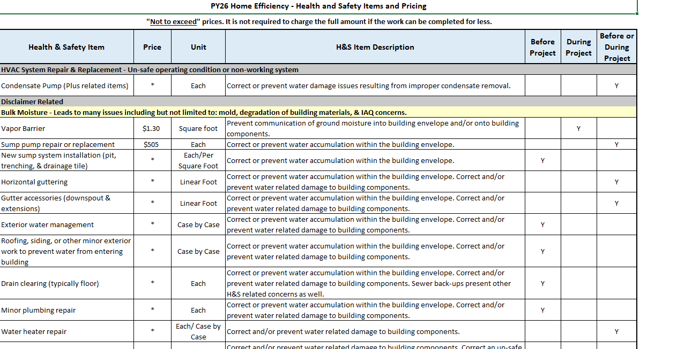
Health & Safety
Refer to the Health and Safety Items and Pricing List
All applicable Health and Safety measures must be performed to include:
  Crawl Space Vapor Barrier
  Bath Fan ventilation
Combustion Safety Testing
Fuel Distribution System Inspection
No greater than 50% of total project cost
If other showstopper Health and Safety conditions exist check with your Field Energy Specialist for potential available funds.
Examples may include but are not limited to:
  Moisture concerns
  Knob and Tube
  ACM
Health & Safety Item | Incentive
Vapor barrier | $1.30/sq ft
Venting exhaust from outside | $190 each

Slide 21
Post Work Requirements
Photograph of insulation levels (3-5 photos)
  General attic photos
    Attic plane air sealing
    Light boxes
    Attic hatch
    Electrical penetrations
Photo of insulation rulers showing insulation levels in attic
Photo of attic access with appropriate damming material used
Fuel Distribution System Inspection
Combustion Safety Testing
Attic insulation level and grading
Infiltration testing CFM@50
Include actual air sealing numbers

