Slide 1
Home Efficiency Market Rate Kickoff Webinar
February 3, 2026

Slide 2
Housekeeping
A recording will be sent out within seven business days along with the slides.
Please place any questions you have in the Q&A section. We will address them at the end of the webinar.
If there is a question you’d like to ask via email, please reach out to Travis Crocker at tcrocker@ameren.com.
Your microphone will be muted throughout the event.

Slide 3
Agenda
Welcome
Meet the Team
Program Overview
Measures and Incentives
Marketing Resources
Q & A

Slide 4
Welcome
Tammy Jackson, Program Supervisor

Slide 5
Meet the Team
Kim Petzing, Senior Program Manager
Notes:
Kim

Slide 6
Home Efficiency Market Rate Team
Kim Petzing, Senior Program Manager
KPetzing-Lehman@Ameren.com
Travis Crocker, Associate Program Manager
Tcrocker@Ameren.com
Pooja Salvi, Senior Program Coordinator
PKhanvilkar@Ameren.com
Osiris Dollar, Operations Analyst
Odollar@Ameren.com
Nick Roess, Marketing Manager/Graphic Designer
nroess@wmenergy.com
Claire Cooper, Marketing Manager
Ccooper@Ameren.com
Latasha Alvin, Customer Experience Center
lalvin@wmenergy.com
Notes:
Kim to go through each person

Slide 7
Program Overview
Kim Petzing, Senior Program Manager

Slide 8
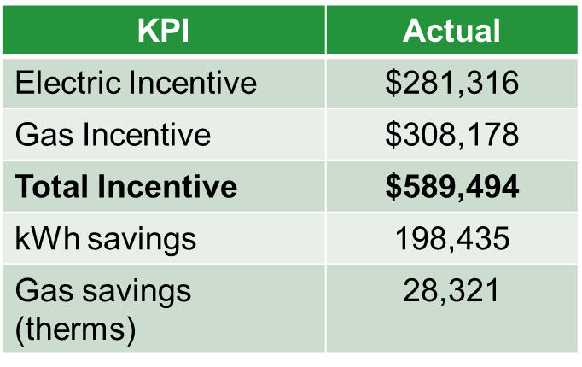
Top Performers
Thank you for a successful 2025!
253 Projects
  Olmstead Brothers Insulation
  Capital Weatherization
  RSP Heating and Cooling
  Central Illinois Insulation, LLC.
  Co-Lab Insulation
  Home Comfort Insulation (106 projects)

Slide 9
2026 Updates and Goals
What’s the same for Home Efficiency Market Rate this year:
  Measures and Incentives
  Workbook
  Submission through the Residential Inbox
  Access to the Program Ally Portal

Slide 10
2026 Updates and Goals
What’s new for Home Efficiency Market Rate this year:
  Increased project goal: 400
  Associate Program Manager, Travis Crocker: Concierge approach with customers and Program Allies
    Working in concert with Field Energy Specialist team
  Pooja Salvi completing data entry, technical review & incentive requests
  Portal submissions (Q1)
  Exploring direct deposit incentive payments
  QA/QC completed by Walker-Miller team
  Dedicated phone line: 1.872.999.6078

Slide 11
Program Measures and Incentives
Travis Crocker, Associate Program Manager

Slide 12
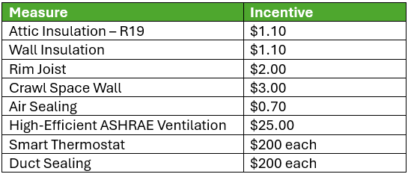
2026 Measure Updates
Measures based on market costs.
  Hearing Program Ally feedback on what measures the program is providing.
  Potential cost adjustments/Program Ally feedback
Measure QA/QC

Slide 13
Marketing Resources

Slide 14


What’s Available
Co-branding requirements
  Logo usage and graphics
Co-branded material
  Submit Co-Branded Marketing Material for Review & Approval
We’re here to assist you
  Reach out to Tucker Blum at tblum@ameren.com for assistance in creating or ordering co-branded Program material.

Slide 15
Upcoming Marketing
Emails: Focused emails will be sent during Q2 and Q4.
Direct Mail Campaigns: Campaigns will launch February and in Q3.
Roundtables through the year
  We will be hosting roundtables through the year to better address any concerns or needs you may have.

Slide 16
Q & A

