Slide 1
Financial literacy
Webinar #2

Slide 2
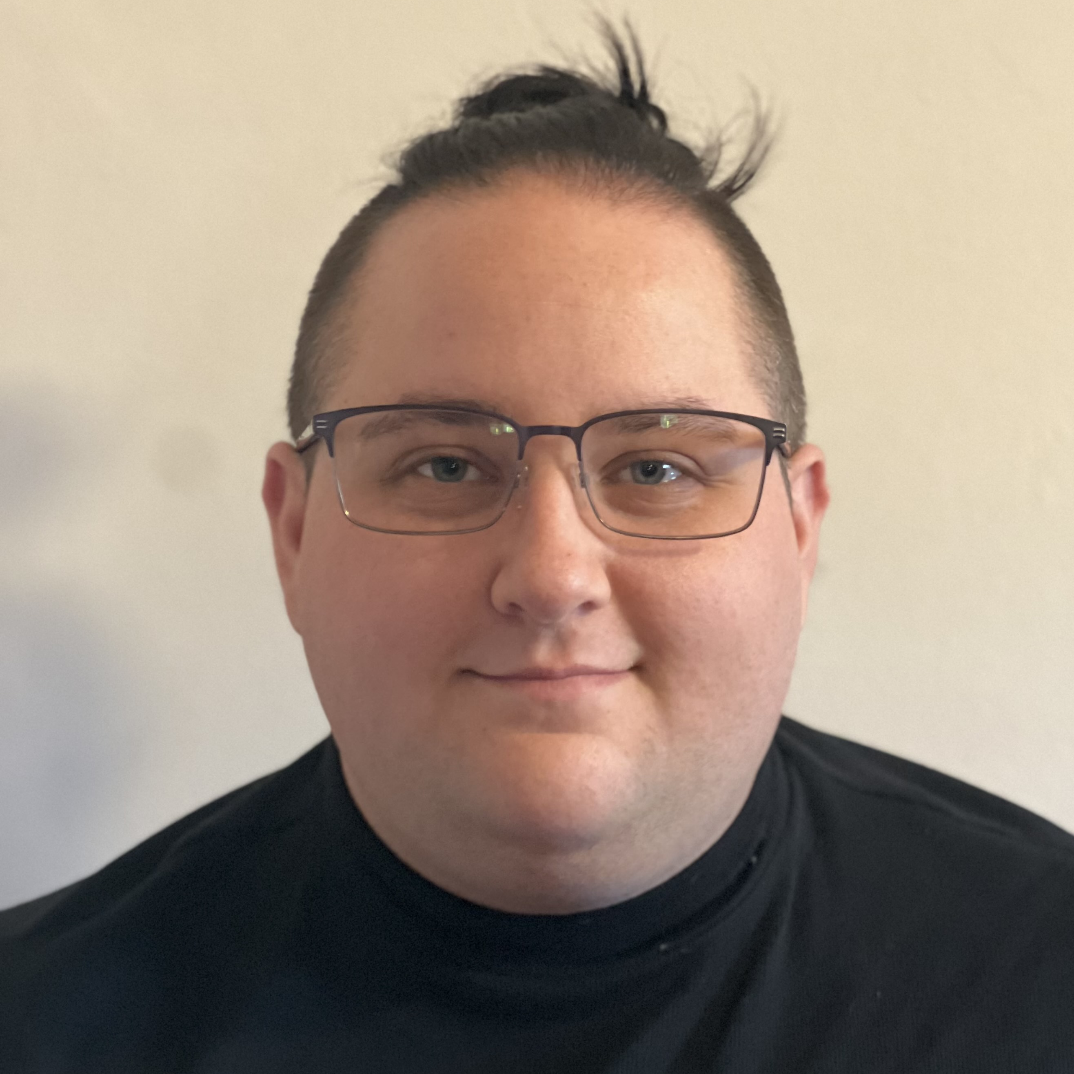
Career spotlight: Nicholas hayes
Marketing administrative coordinator
ameren Illinois energy efficiency program
Leidos, inc.

Slide 3
Guest speaker: Brittany strickland
Vice President Community Manager
j.p. morgan chase bank

