Slide 1
ameren Illinois energy assistance Programs
+ Equity and inclusion
Webinar #5

Slide 2
CAREER SPOTLIGHT: Keith Cronin
Senior Consultant, CMVP
VEIC

Slide 3
Career spotlight: susan sams
Executive director, energy assistance foundation
Warm neighbors cool friends program

Slide 4
Guest speaker: Daniel bradshaw
Customer service specialist, energy assistance
Ameren illinois

Slide 5

Energy Assistance
Low Income Home and Energy Assistance Program (LIHEAP)
Federally and state funded
Income-eligible customers up to 60% of state median income
Administered through a network of local agencies
Direct vendor payment
  Income
  Heating Source
  Household Size
Reconnection assistance (up to $1,500)
Program Year October 1 – August 15 or until funds are depleted
Waives deposits and late payment charges

Slide 6
Energy Assistance
Warm Neighbors Cool Friends (WNCF)
Funded by donations
Income-eligible customers 80% area median income and 300% of federal poverty level
Administered through the Energy Assistance Foundation and a network of local agencies
Pledge primarily through Ameren’s Energy Assistance Portal
Payment matching grant up to $500 (heating); up to $400 (cooling)
Heating Season October 1 – May 31
Cooling Season June 1 – September 30
Waives deposit and late payment charges
Additional $2 million in 2026

Slide 7
Energy Assistance
Income Charts for Program Year 2026
LIHEAP
WNCF
Household Size
Income Range
Household Size
Income Range
1
2
3
4
5
6
7
8
$0 – $3,332
$0 – $4,357
$0 – $5,382
$0 – $6,407
$0 – $7,432
$0 – $8,457
$0 – $8,649
$0 – $8,842
1
2
3
4
5
6
7
8
$3,333 – $4,713
$4,357 – $5,383
$5,382 – $6,663
$6,407 – $8,037
$7,432 – $9,414
$8,458 – $10,788
$8,649 – $12,162
$8,842 – $13,539

Slide 8
Energy Assistance
Supplemental Arrearage Reduction Program (SARP)
Natural Gas Discount Program
Deposit and Late Fee Waiver
Electric Service Discount Program (COMING SOON!)
Must be eligible for LIHEAP
Over 11,000 customers currently enrolled
Over $3,300,000 in credits given
Automatically enrolled when income is certified with LIHEAP agency
Can currently self-certify on Ameren.com
Application can be found on Ameren.com
Submit proof of income for approval
Enrolled after applying for LIHEAP
Meet energy burden
Other Programs

Slide 9
Questions about energy assistance programs?

Slide 10
Guest speaker: scott alan davis
Vice president of inclusion and economic development
Seel (solutions for energy efficiency logistics), llc

Slide 11
What is Energy Equity?
Energy equity ensures that all individuals and communities have access to affordable and reliable energy services by educating the public about energy reduction, renewable and clean energy practices that reduce energy use and carbon emissions.
Notes:
Many groups have historically been underserved by energy efficiency and other clean energy investments, including Black communities, Indigenous communities, people of color, low-income individuals, youth, older adults, recently arrived immigrants, those with limited English proficiency, and people with disabilities.
Advancing equity in energy efficiency and clean energy programs, policies, and investments can ensure that disinvested communities benefit from the clean energy transition. Energy efficiency can reduce energy costs, create jobs, and promote health, safety, and well-being, but efficiency policies and programs can increase inequities if they do not include disinvested communities in these benefits.
source: https://www.seelllc.com/elois-Thomas; accessed May 2026
Source: https://www.aceee.org/topic/energy-equity; accessed May 2026

Slide 12
A Fair Energy System
Institutionalizes accountability for achieving outcomes from government, utilities and other stakeholders
Embeds inclusive, accessible, and authentic community engagement in the development of policies and programs
Recognizes and addresses historical, cultural, and institutional dynamics and structures that created past and current barriers
Ensures representation, power, and influence from community members and environmental justice advocates in decision-making and implementation processes
Considers intergenerational impacts and does not create policies or programs that burden future generations
Achieves a fair distribution of opportunities, benefits and burdens for all communities
Notes:
Just as the MDI does, the greater energy system is making strides in its path to equity. Creating a clean and equitable energy system requires accountability, inclusivity and accessibility. The characteristics of an equitable energy system shown in these boxes guide the industry in determining if the energy efficiency sector, or a particular policy or program, is moving toward an equitable future.
https://www.aceee.org/topic/energy-equity

Slide 13
Energy Affordability
Energy affordability is the idea that consumers should be able to pay for their home energy use while also paying for other basic living expenses, such as food and medication, without having to choose or feel overburdened.
Notes:
There are a couple of other common terms to learn about when it comes to talking about an equitable energy system. Energy affordability is the idea that consumers should be able to pay for their home electricity use—lighting, heating, cooling, powering appliances—while also paying for other basic living expenses, such as food and medication, without having to choose or feel overburdened.
Key part of energy affordability links back to equity and community. Older housing stock typically is less efficient and has older equipment in it. This becomes more expensive to use as time goes on, which leads to these areas having a higher energy burden.

Slide 14
Energy Burden
Household Income
Energy Burden
Energy Costs
Notes:
Energy burden refers to the percentage of a household’s median annual income that is used to pay for electricity and gas
Energy bills strain many household budgets, and some far more than others. Research has found that low-income, Black, Hispanic, and disadvantaged households all face dramatically higher energy burdens than the average household. High energy burdens are correlated with greater risk for respiratory diseases, increased stress and economic hardship, and difficulty in moving out of poverty.
2024 Energy Burden Report Update: One in Four Low-Income Households Spend Over 15% of Income on Energy Bills (source: https://www.aceee.org/energy-burden, accessed march 2025)

Slide 15
The market development initiative (MDI)
Leads With Equity
Notes:
The Clean & Equitable MDI is a comprehensive suite of resources designed to transform the energy landscape by prioritizing access for all, fostering innovation, promoting community-led solutions and creating clean energy champions. The C&E MDI has three foundational goals: ▪ Access: Develop and implement clean energy programs and initiatives that aim to educate & reduce the energy burden and are inclusive of all customer. ▪ Vendor Opportunities: Expand industry-wide network of vendors and suppliers providing energy related services and products that benefit the communities in or near where they reside. ▪ Workforce Opportunities: Connecting candidates to clean energy career opportunities within or near their communities, particularly in EIEC areas, through innovative workforce solutions, educational and training programs, and community partnerships.

Slide 16
MDI Offerings
Community-Based Organization (CBO) Management
Workforce Development
Vendor Advancement and Transformation
Serves jobseekers, career changers, students and employers
Scholarship and internship opportunities
Partners with local nonprofit organizations and community action agencies to engage customers with energy program resources
Supports new and growing energy-related businesses with trainings and customized resources
Builds a network of locally owned businesses that can support the needs of Ameren Illinois program staff and partners
Energy Jobs Board: IllinoisEnergyEfficiencyJobs.com
Notes:
A Community-Based Organization (CBO) is a local group dedicated to serving its community—through education, outreach or direct services. Our partnerships with CBOs help expand access to clean energy programs, create lasting relationships and drive meaningful change in the communities we serve.
The Workforce Development Channel provides a wide array of support for jobseekers seeking to find work in energy efficiency. There are several means through which jobseekers are provided opportunities to enter energy efficiency, as well as breaking down barriers to obtaining a job. The primary areas of Workforce Development consist of providing jobseekers with services and support, introducing opportunities to obtain scholarships at partnering community colleges, connections to the internship program, targeting specific geographic areas, and partnering with other entities to identify other areas of need.

Slide 17
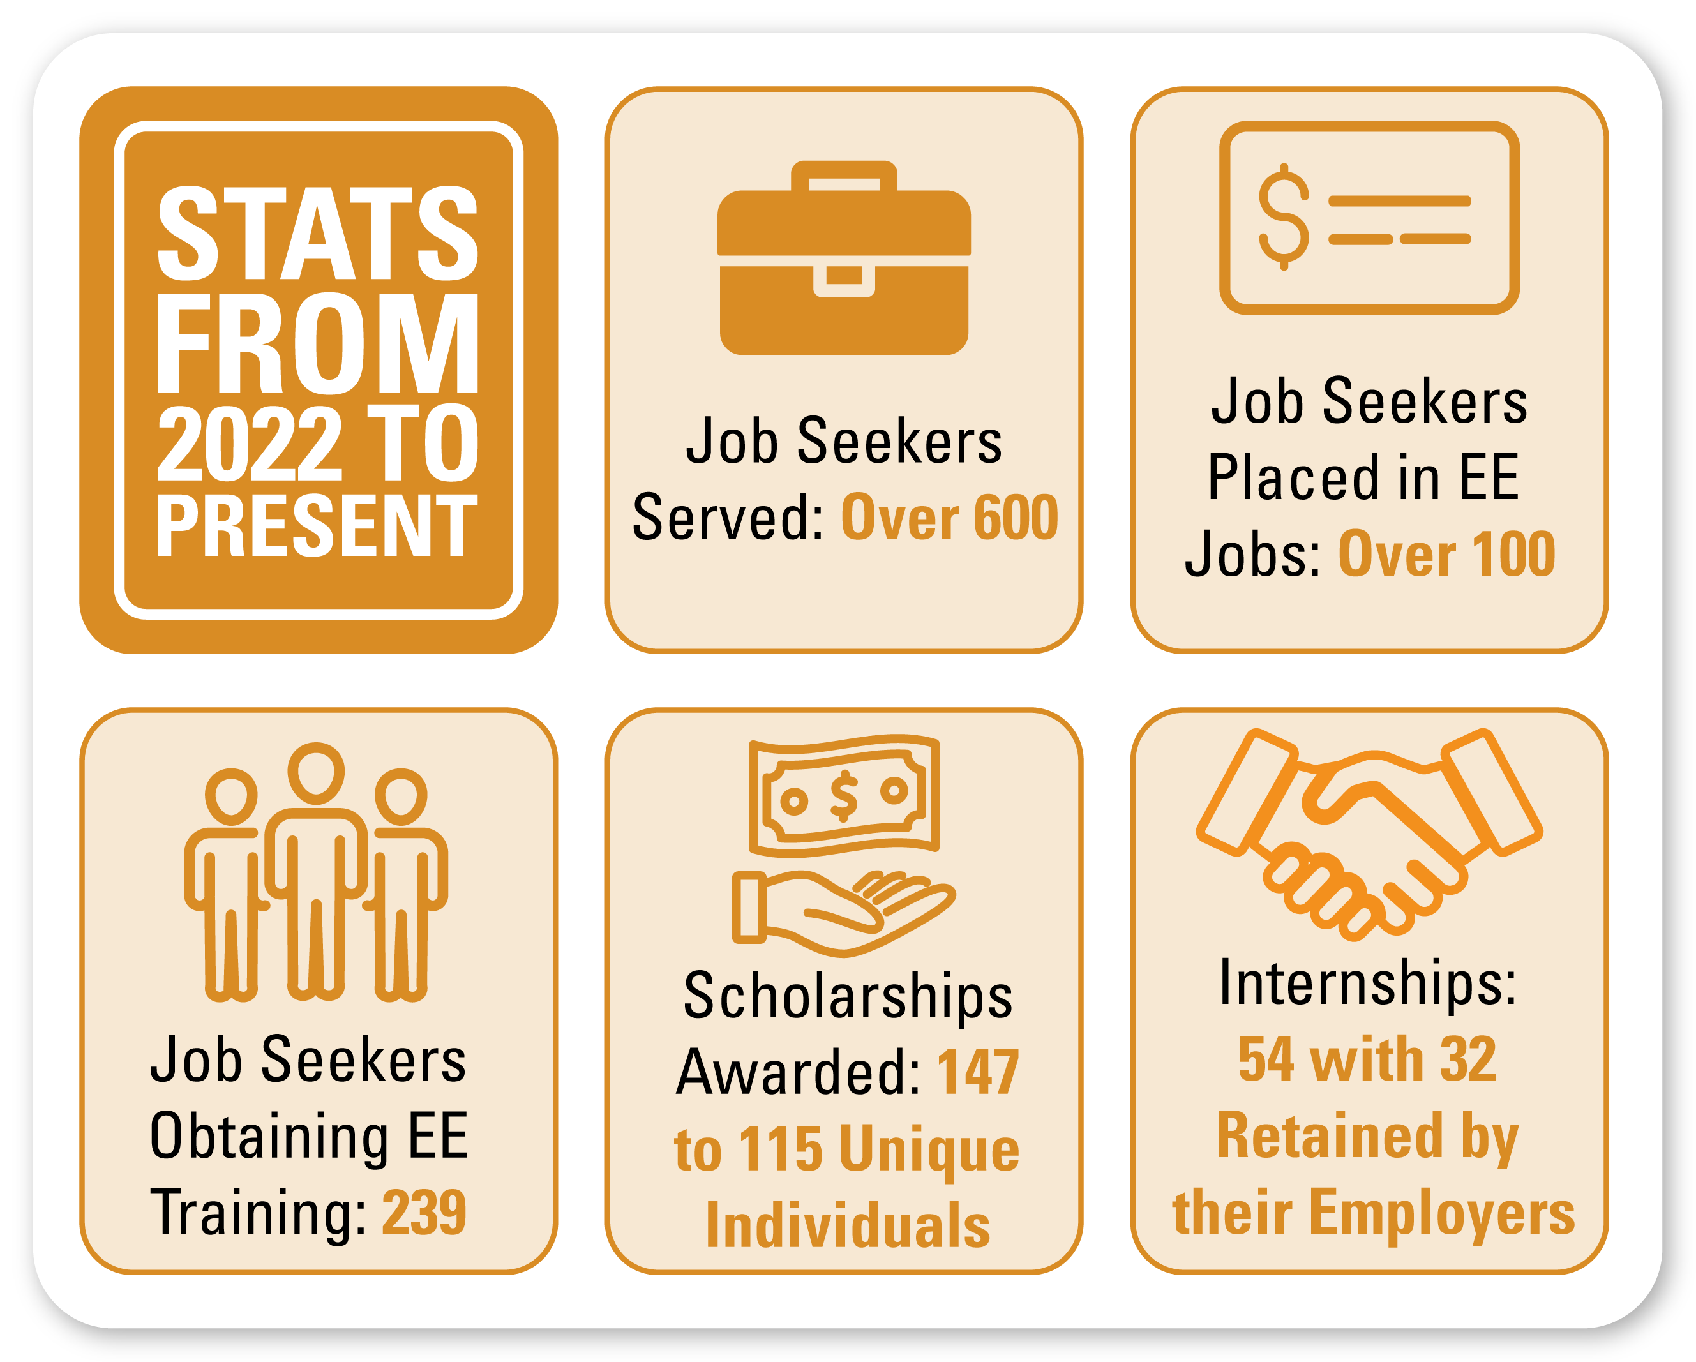
YEAR IN REVIEW

Slide 18
Equitable workforce development program design

Slide 19
Income-qualified energy program design
Notes:
Discuss iq programs that are designed to remove barriers so income-qualified customers can experience energy improvements where they live. Our approach combines financial assistance, community-based outreach, and tailored program delivery to ensure equitable access and measurable impact.

Slide 20
Accessibility and mobility in energy program design
Notes:
Discuss accessibility programs – smart home technology that builds independence

Slide 21
Community engagement that builds trust
Notes:
Discuss the benefit of incorporating community engagement in all types of energy programs. Why it’s important to meet people where they are, partnering with trusted community organizations to drive program participation and customer satisfaction. Taking a community-first approach is rooted in outreach expertise, cultural competency, and a commitment to inclusivity.

Slide 22
Questions?

Slide 23
next webinar: the smart grid

